Slide 1
Assertive Communication

Slide 2
Two weeks ago you started a new job at a local café. Last night you worked the closing shift for the first time all by yourself. You show up for work the next morning, and your manager immediately pulls you aside and accuses you of not doing your job properly: “What were you doing last night?! I came in this morning and things were an absolute mess!!” You’re confused and upset. You thought you had followed the to-do list provided by your manager and closed the café properly.

Slide 3
Q1: How do you think you would respond to your manager’s accusation? A) “Oh … I’m so sorry” (Crap … I probably did something wrong) B) “What do you mean?? I was following the list YOU provided!” C) “I’m sorry things were a mess this morning. I thought I had closed up properly, so this is surprising to me.” D) “Uhh … okay …” (This guy’s an idiot)

Slide 4
What are the main styles of communication?
Aggressive: bossy, arrogant, bulldozing, intolerant, opinionated, and overbearing.
Passive: helpless, indecisive, and apologetic.
Passive Aggressive: sarcastic, deceiving, ambiguous, insinuating, manipulative, and guilt-inducing.
Assertive Communication: direct, honest, accepting, responsible, and spontaneous.
Notes:
change colours for the black pages

Slide 5
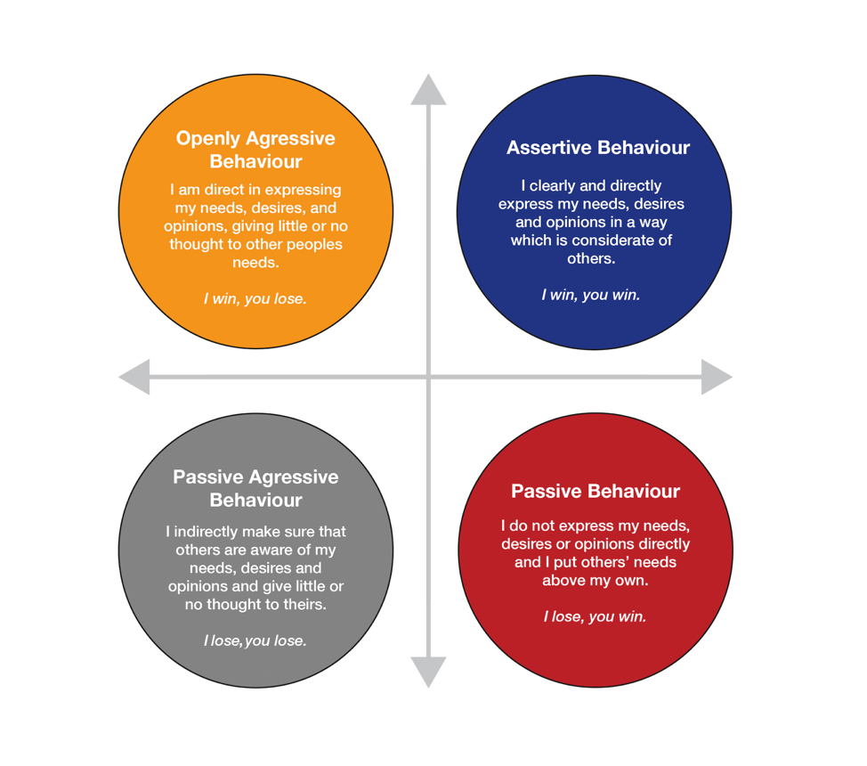
Communication
Styles

Slide 6
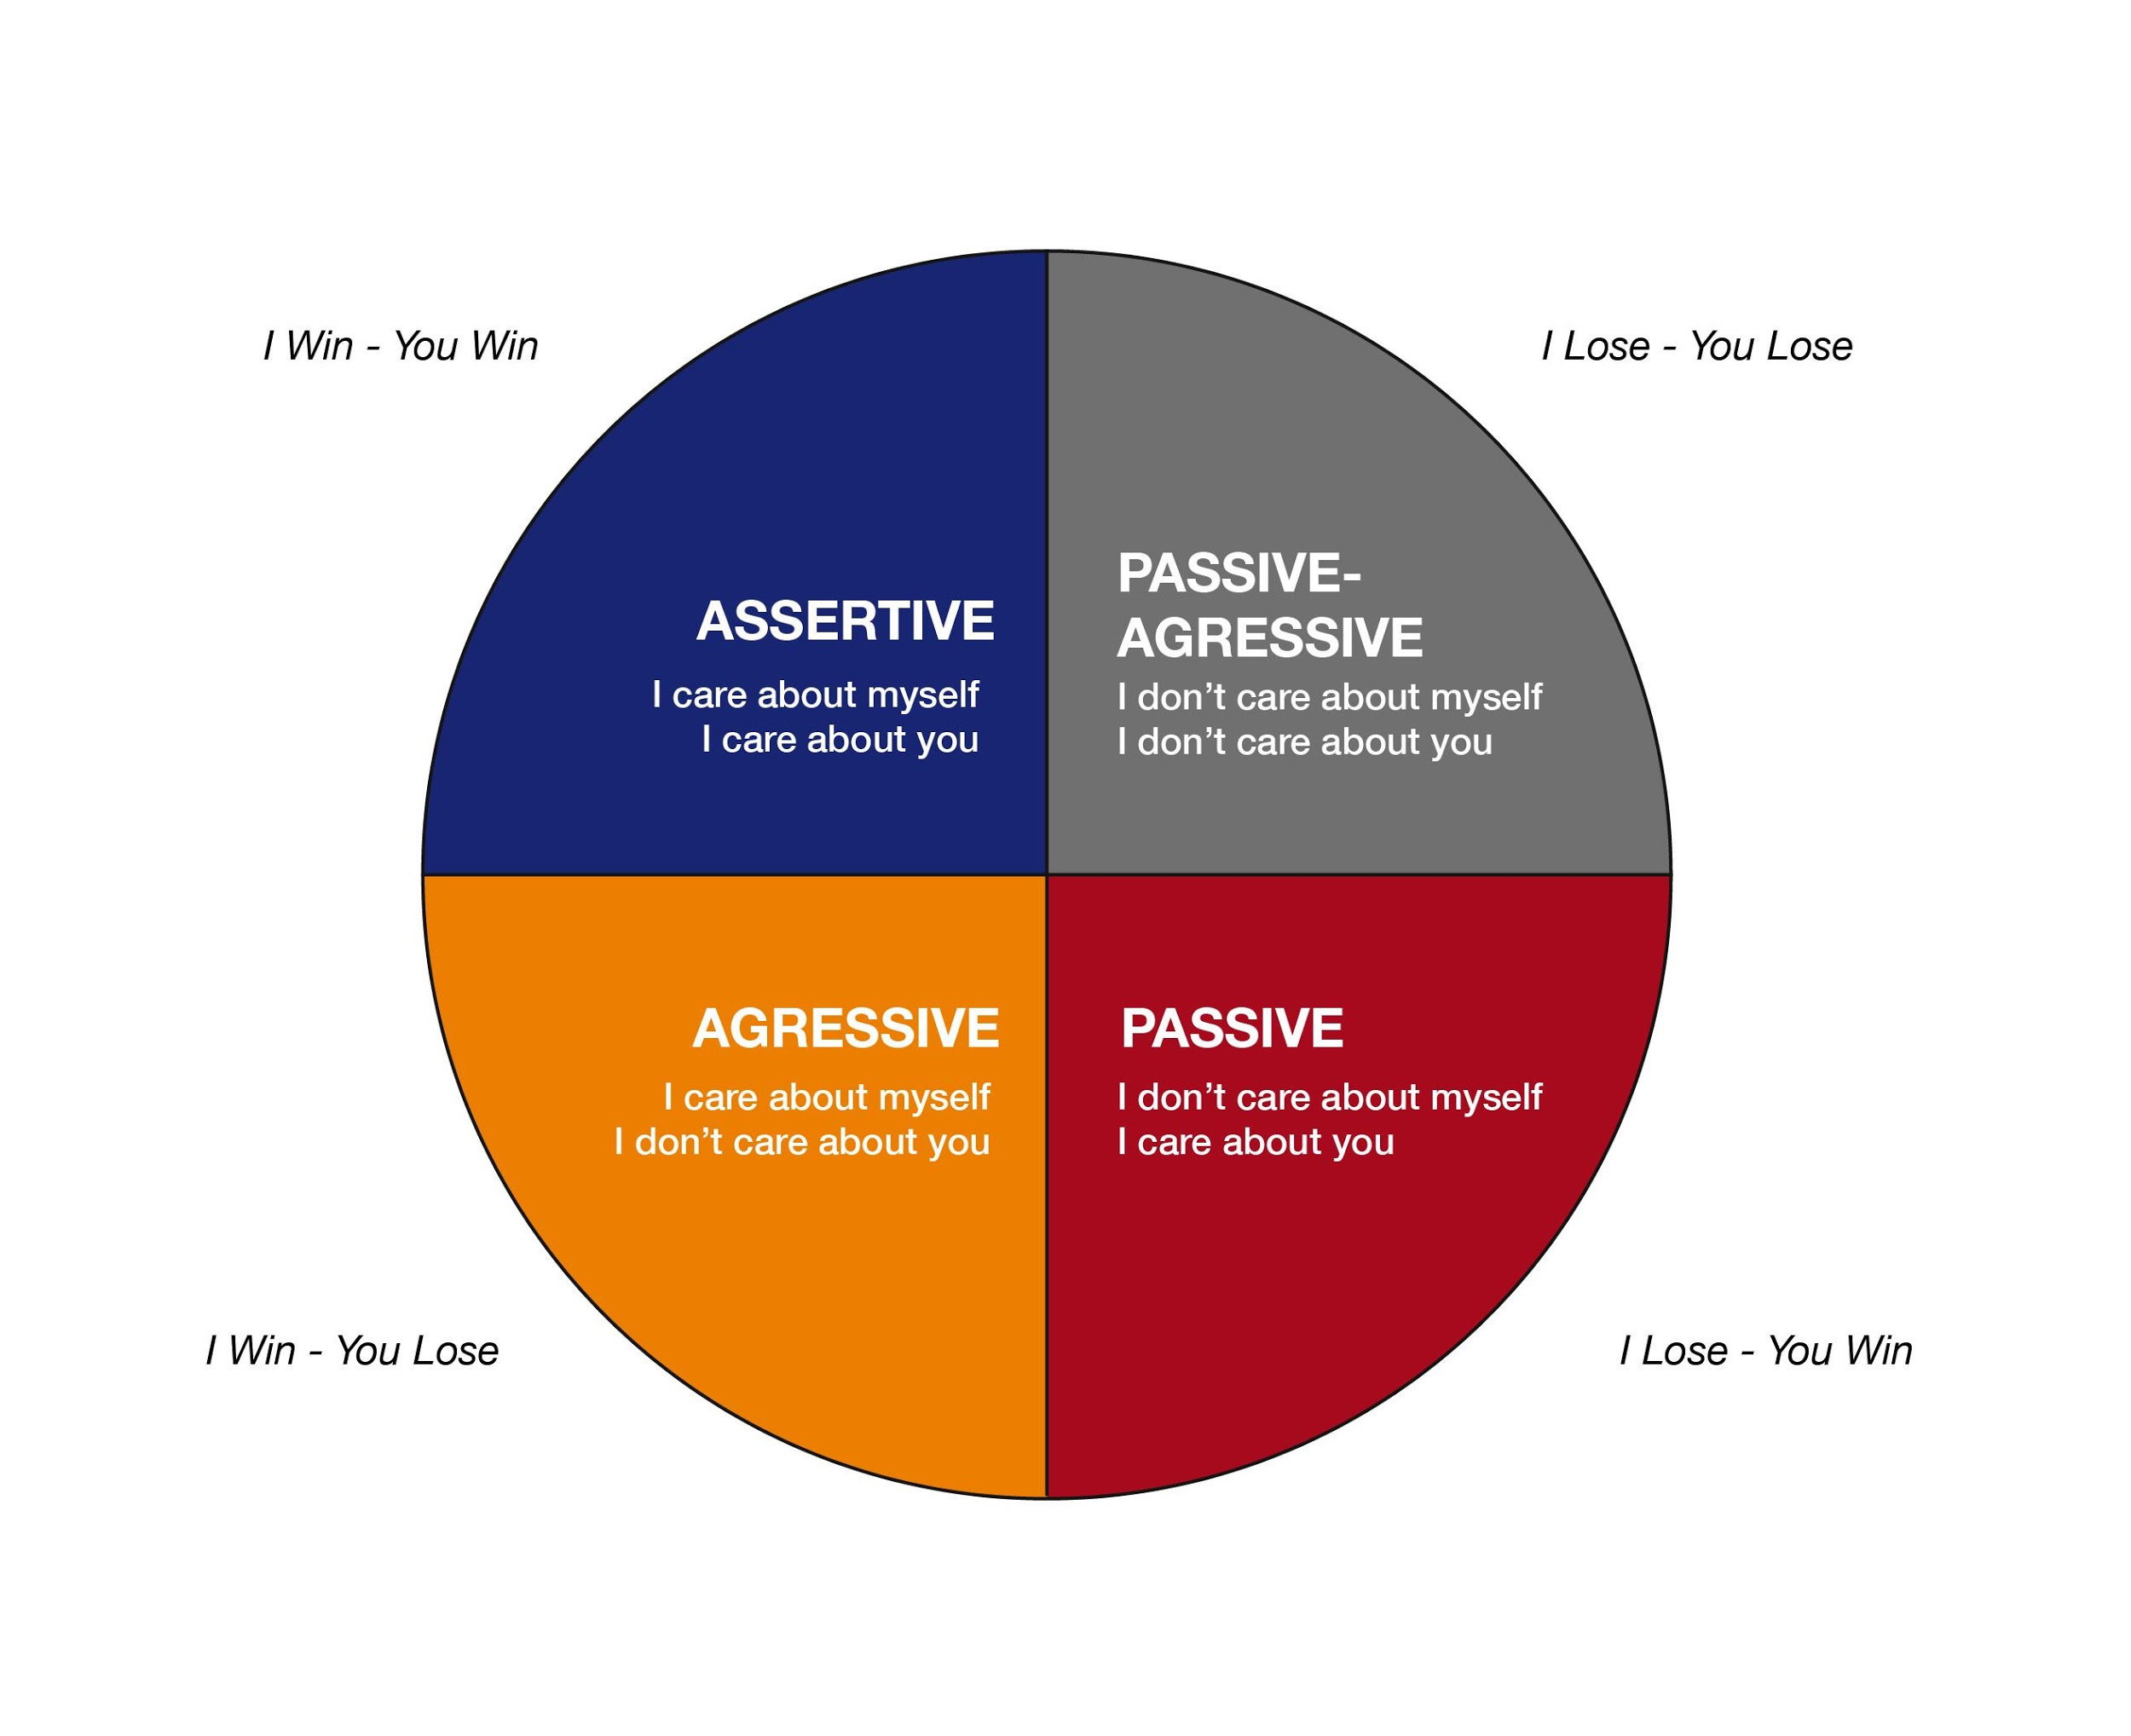
How Each Communication
Style Is Perceived

Slide 7
What is Aggressive Communication?
Aggressive Communication is a style in which individuals express their feelings and opinions and advocate for their needs in a way that violates the rights of others. Thus, aggressive communicators are verbally and/or physically abusive.

Slide 8
Why People Use an Aggressive Style of Communication
To Intimidate others -- may get things done but people will begin to resent you and fear you
To feel powerful - but short lived
They feel threatened, possibly because of low self esteem
They fail to understand the negative consequences – “It has worked before”
It is a learned behavior

Slide 9
Aggressive communicators will often:
try to dominate others
use humiliation to control others
criticize, blame, or attack others
be very impulsive
have low frustration tolerance
speak in a loud, demanding, and overbearing voice
act threateningly and rudely
not listen well
interrupt frequently
use “you” statements
have an overbearing or intimidating posture
Notes:
to be cut

Slide 10
Aggressive communicators will say, believe, or behave like:
“I’m superior and right and you’re inferior and wrong.”
“I’m loud, bossy and pushy.”
“I can dominate and intimidate you.”
“I can violate your rights.”
“I’ll get my way no matter what.”
“You’re not worth anything.”
“It’s all your fault.”
“I react instantly.”
“I’m entitled.”
“You owe me.”
“I own you.”
Notes:
to be cut

Slide 11
Aggressive Communication Patterns:
become alienated from others
alienate others
generate fear and hatred in others
always blame others instead of owning their issues, and thus are unable to mature

Slide 12
What is Passive Communication?
Passive Communication is a style in which individuals have developed a pattern of avoiding expressing their opinions or feelings, protecting their rights, and identifying and meeting their needs. As a result, passive individuals do not respond overtly to hurtful or anger-inducing situations. Instead, they allow grievances and annoyances to mount, usually unaware of the buildup. But once they have reached their high tolerance threshold for unacceptable behavior, they are prone to explosive outbursts, which are usually out of proportion to the triggering incident. After the outburst, however, they may feel shame, guilt, and confusion, so they return to being passive.

Slide 13
Why People Use A Passive Style of Communication
They feel like they don’t have control over their own lives
They don’t trust that they can do things effectively
Their role in life is to be a servant
If I don't do what others want - will they still like me?
Learned helplessness

Slide 14
Passive communicators will often…
fail to assert themselves
allow others to deliberately or inadvertently infringe on their rights
fail to express their feelings, needs, or opinions
tend to speak softly or apologetically
exhibit poor eye contact and slumped body posture
Notes:
to be cut

Slide 15
A passive communicator will say, believe, or behave like…
“I’m unable to stand up for my rights.”
“I don’t know what my rights are.”
“I get stepped on by everyone."
“I’m weak and unable to take care of myself.”
“People never consider my feelings.”
Notes:
to be cut

Slide 16
Passive Communication Patterns:
often feel anxious because life seems out of their control
often feel depressed because they feel stuck and hopeless
often feel resentful (but are unaware of it) because their needs are not being met
often feel confused because they ignore their own feelings
are unable to mature because real issues are never addressed

Slide 17
What is Passive Aggressive Communication?
Passive Aggressive Communication is a style in which individuals appear passive on the surface but are really acting out anger in a subtle, indirect, or behind-the-scenes way. People who develop a pattern of passive-aggressive communication usually feel powerless, stuck, and resentful – in other words, they feel incapable of dealing directly with their resentments so instead, they express their anger by subtly undermining.

Slide 18
Why People Use a Passive Aggressive Style of Communication
Feeling really angry and resentful
They need to be in control but are not confident enough to be direct
They fear the possible consequences of expressing themselves directly
To avoid being responsible for their own actions
Notes:
to be cut

Slide 19
Passive Aggressive communicators will often:
mutter to themselves rather than confront the person or issue
have difficulty acknowledging their anger
use facial expressions that don't match how they feel - i.e., smiling when angry
use sarcasm
deny there is a problem
appear cooperative while purposely doing things to annoy and disrupt
use subtle sabotage to get even
Notes:
to be cut

Slide 20
The passive-aggressive communicator will say, believe, or behave like…
“I’m weak and resentful, so I sabotage, frustrate, and disrupt.”
“I’m powerless to deal with you head on.”
“I will appear cooperative but I’m not.”

Slide 21
Passive Aggressive Communication Patterns:
become alienated from those around them
remain stuck in a position of powerlessness
discharge resentment while real issues are never addressed so they can't mature

Slide 22
What is Assertive Communication?
Assertive Communication is a style in which individuals expresses both positive and negative ideas in an open, honest and direct way. They clearly state their opinions and feelings, and firmly advocate for their rights and needs without violating the rights of others. These individuals value themselves, their time, and their emotional, spiritual, and physical needs and are strong advocates for themselves while being very respectful of the rights of others. Assertive communicators avoid judgement or blame and allow both parties to have their needs met; constructively rather than emotionally

Slide 23
Why Use Assertive Communication?
Helps us feel good about ourselves and others
Leads to the development of mutual respect with others
Helps achieve goals
Minimizes hurting and alienating other people
Protects us from being taken advantage of by others
Enables us to make decisions and free choices in life
Enables us to express, both verbally and non-verbally, a wide range of feelings and thoughts, both positive and negative

Slide 24
Five Main Characteristics of Assertive Communication
Eye contact: demonstrates interest, shows sincerity
Body language: open body language will improve the significance of the message
Voice: a level, well-modulated tone is more convincing, acceptable, and non-intimidating
Timing: use your judgement to maximise receptivity and impact
Content: what you say is just as important as how, where and when you choose to communicate

Slide 25
Assertive Communicators will…
state needs and wants clearly, appropriately, and respectfully
express feelings clearly, appropriately, and respectfully
use “I” statements
communicate respect for others
listen well without interrupting
feel in control of self
have good eye contact
speak in a calm and clear tone of voice
have a relaxed body posture
feel connected to others
feel competent and in control
not allow others to abuse or manipulate them
stand up for their rights

Slide 26
Assertive Communicators will say, believe, or behave like…
“We are equally entitled to express ourselves respectfully to one another.”
“I am confident about who I am.”
“I realize I have choices in my life and I consider my options.”
“I speak clearly, honestly, and to the point.”
“I can’t control others but I can control myself.”
“I place a high priority on having my rights respected.”
“I am responsible for getting my needs met in a respectful manner.”
“I respect the rights of others.”
“Nobody owes me anything unless they’ve agreed to give it to me.”
“I’m 100% responsible for my own happiness.”

Slide 27
Assertive Communication Patterns:
feel connected to others
feel in control of their lives
are able to mature because they address issues and problems as they arise
create a respectful environment for others to grow and mature

Slide 28
Q2: Label the following statements according to their communication style (Passive, Aggressive, Passive aggressive, Assertive)
A) “Oh … I’m so sorry” (Crap … I probably did something wrong) B) “What do you mean?? I was following the list YOU provided!” C) “I’m sorry things were a mess this morning. I thought I had closed up properly, so this is surprising to me.” D) “Uhh … okay …” (This guy’s an idiot)

Slide 29
Q3: How do you tend to communicate?

Slide 30
Remember…
Behaviours are NOT personality types
We all use different communication styles at different times – public vs. private
TIMING is everything!
You can only control yourself, you cannot control how people respond or react
You always have a CHOICE

Slide 31
End

